Slide 1
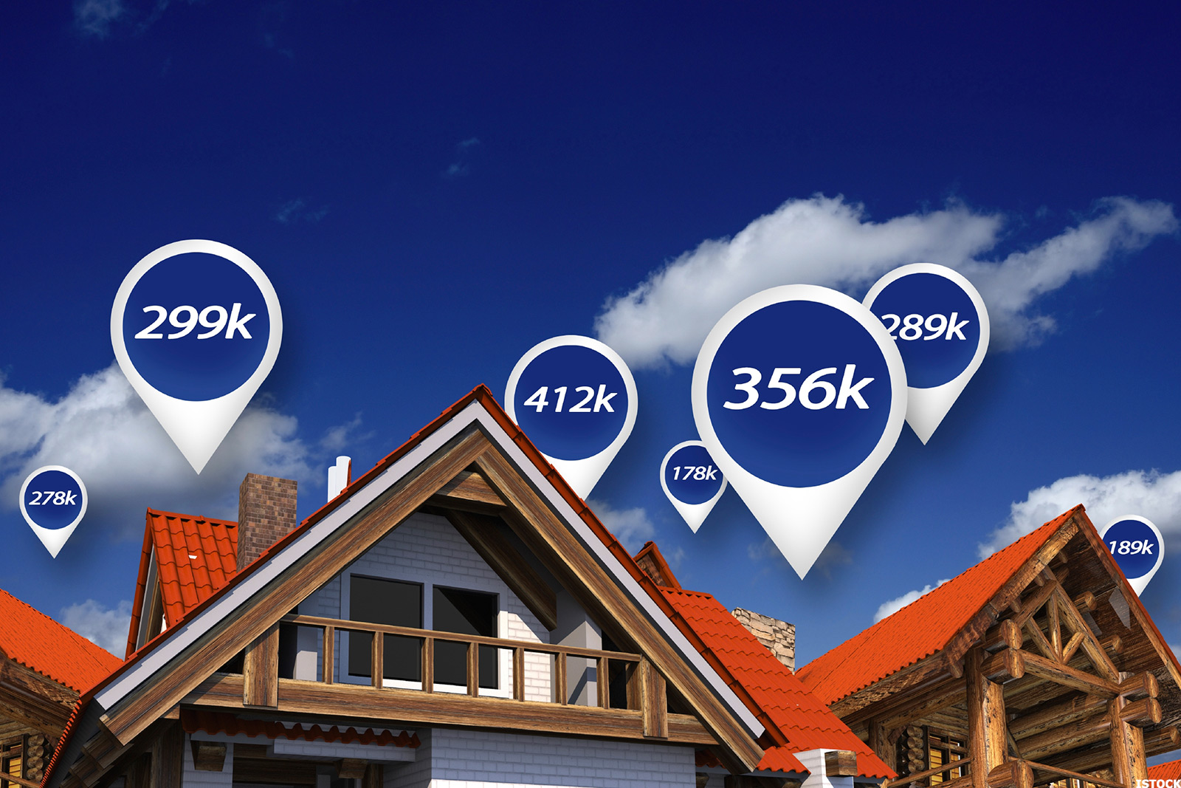

Demystifying ML
Final Project
Predicting Housing Prices for FL - Regions in US

Slide 2
OVERVIEW:
The goal of this project is to help out my neighbor, a real estate agent, who asked for some help on predicting housing prices for FL regions in the USA. In the context of ML, my work will be principally focused on creating the most suitable models that allows her to put in a few features of a house and returns back an estimate of what the house would sell for.
Methodology:
End to end Machine learning process in python to create and compare multiple models to predict the price of house based on the variables in the data set
Use Scikit-Learn machine learning library
Use various python tools for data acquisition, cleaning and visualization: Pandas, NumPy, Seaborn, Matplotlib
Use the power of Tableau for specific visualizations
Data sources: Zillow housing data , ZIP atlas
Data Acquisition
Data Cleaning
Train Dataset
Train ML Model
Test Model
Evaluate Model
Deploy Model
Most time spent here

Slide 3
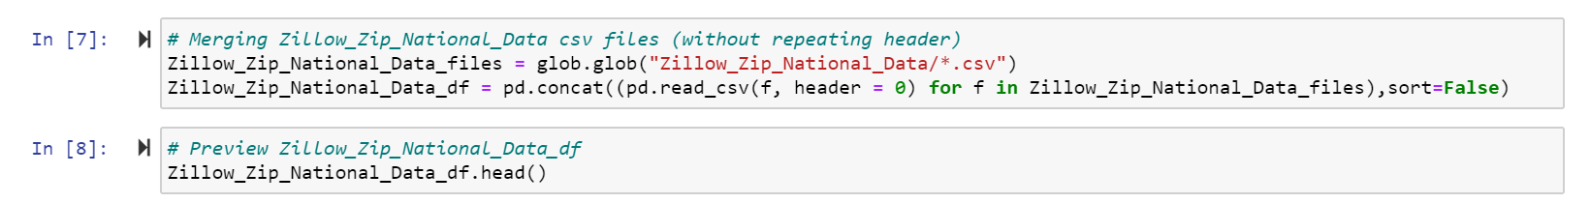
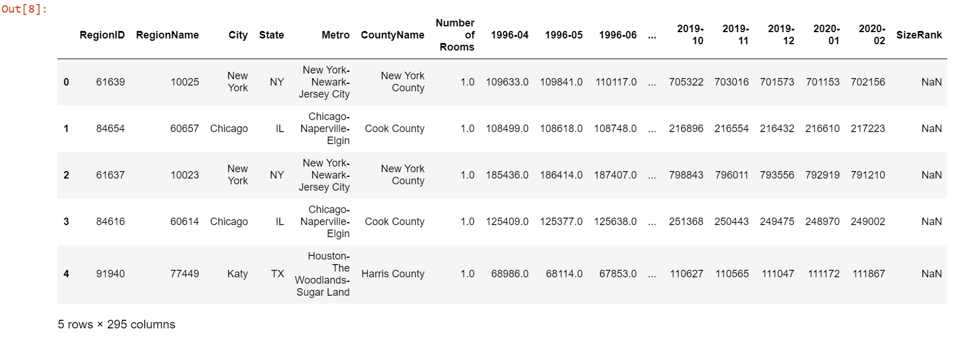
DATA ACQUISITION:
Zillow Dataset:
A total of 5 csv files were downloaded : Zip_zhvi_1bedroocsvm.csv, Zip_zhvi_2bedroom.csv, Zip_zhvi_3bedroom.csv, Zip_zhvi_4bedroom.csv, Zip_zhvi_5bedroomOrMore.
Globe module was used to retrieve all the csv files
Pandas concat function was used to concatenate / merge all the csv files

Slide 4
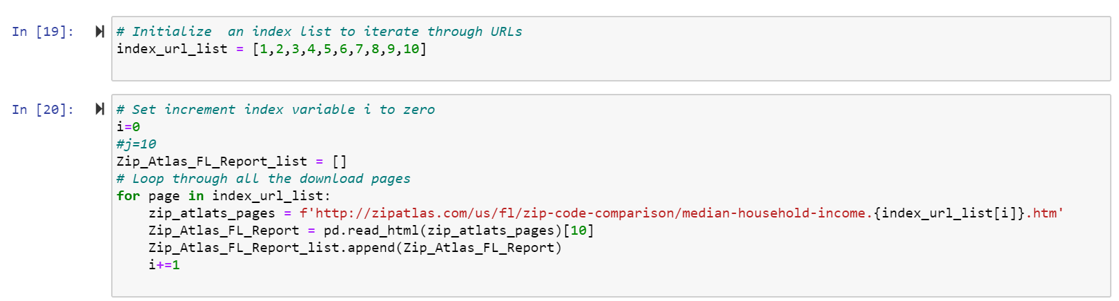
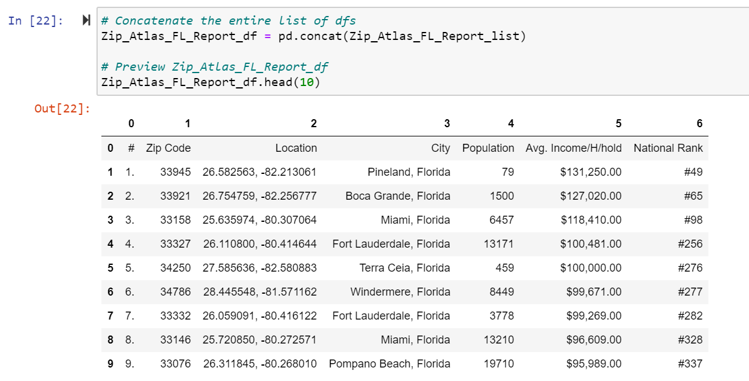
DATA ACQUISITION:
ZIP atlas Dataset:
I created a For loop to iterate dynamically through all the ZIP atlas URL pages, read each table, and append all of them to a list
Pandas concat function was used to concatenate all the tables included in the list

Slide 5
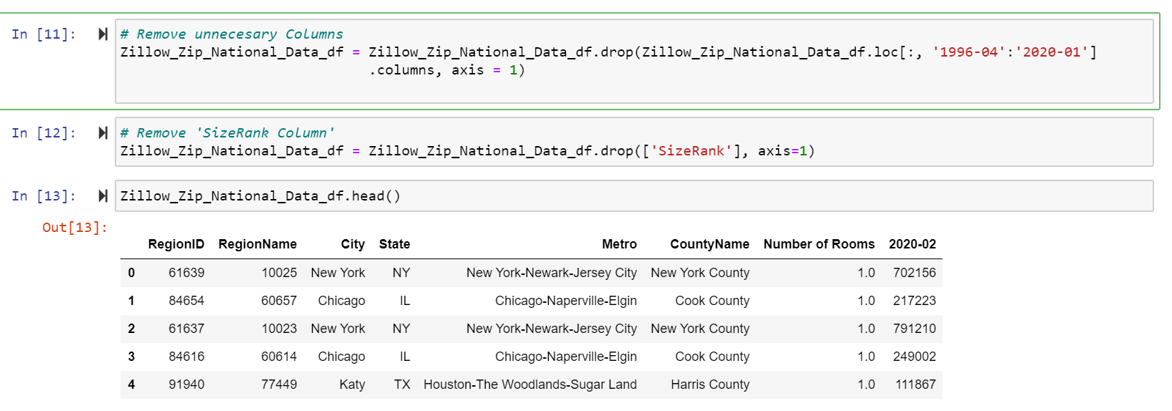
DATA CLEANING:
Zillow Dataset:
Prices from 1996-04 – 2020-01 were removed to keep the most updated price ‘2020-02’
Additionally ‘SizeRank’ column was removed (no relevant NaN data)

Slide 6
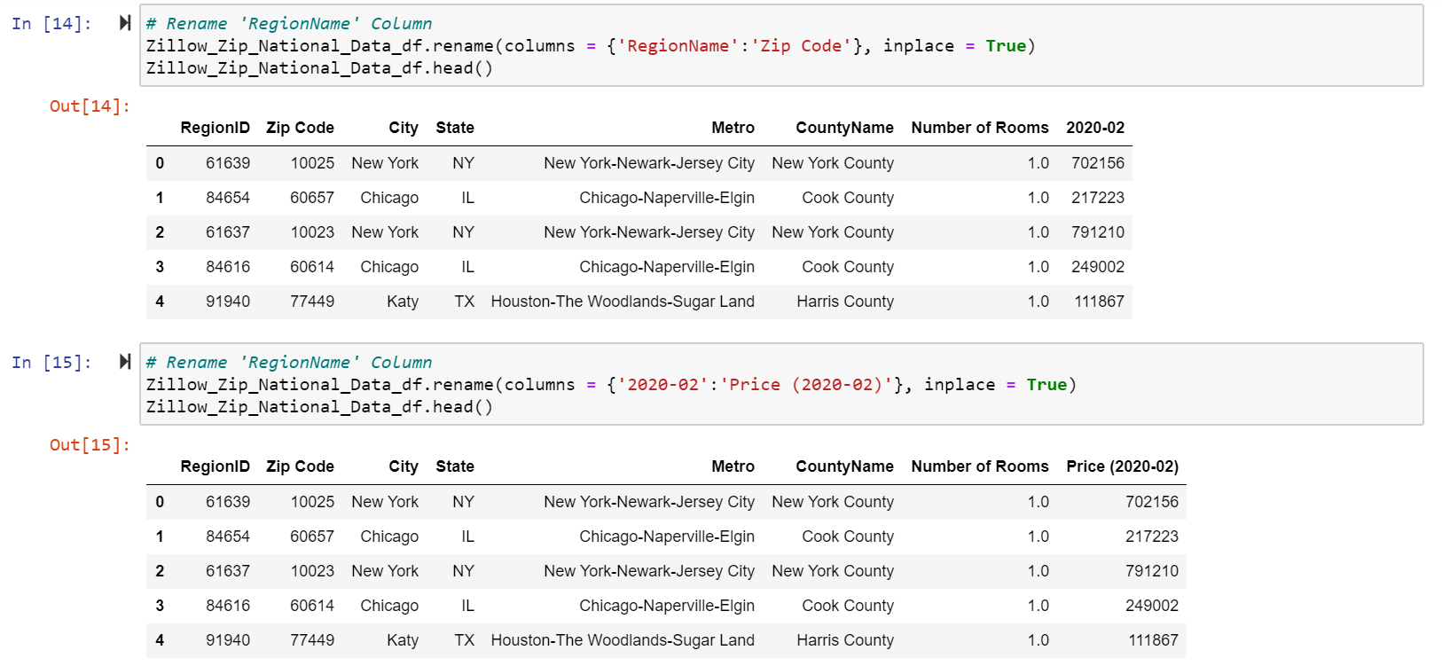
DATA CLEANING:
Zillow Dataset:
‘RegionName’ column was renamed to ‘Zip Code’ as a preparation for further merging based on this column
‘2020-02’ column was renamed to ‘Price (2020-02)’ to provide more clarity about the content in this column

Slide 7
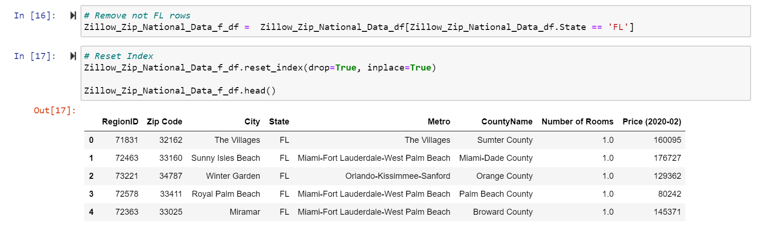
DATA CLEANING:
Zillow Dataset:
Data frame was filtered by State matching FL
The index was reset to reestablish the correct order

Slide 8
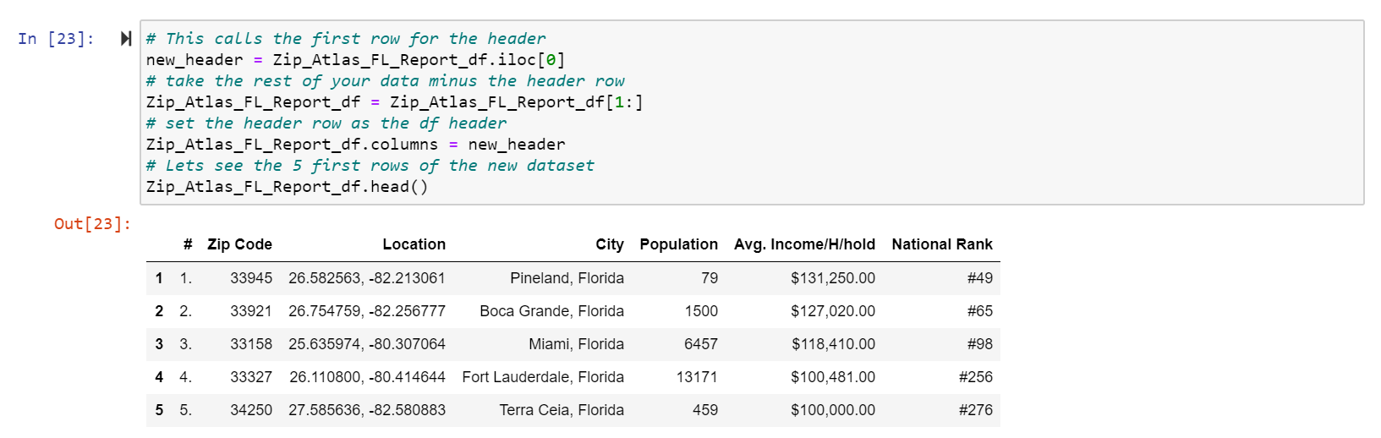
DATA CLEANING:
ZIP atlas Dataset:
The first row including the original df header was moved to the top header
The rest of repeated headers during concatenation were also removed

Slide 9
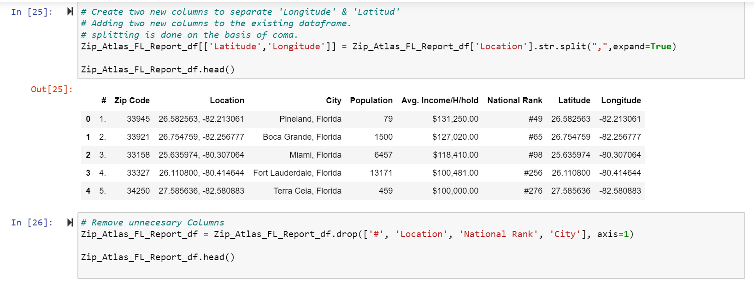
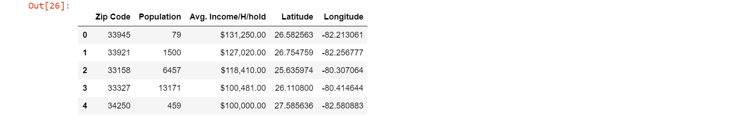
DATA CLEANING:
ZIP atlas Dataset:
Using split function, based on ‘,’ we separated the string content under Location for latitude and longitude
New columns were created ‘Latitude’ , ‘Longitude’

Slide 10
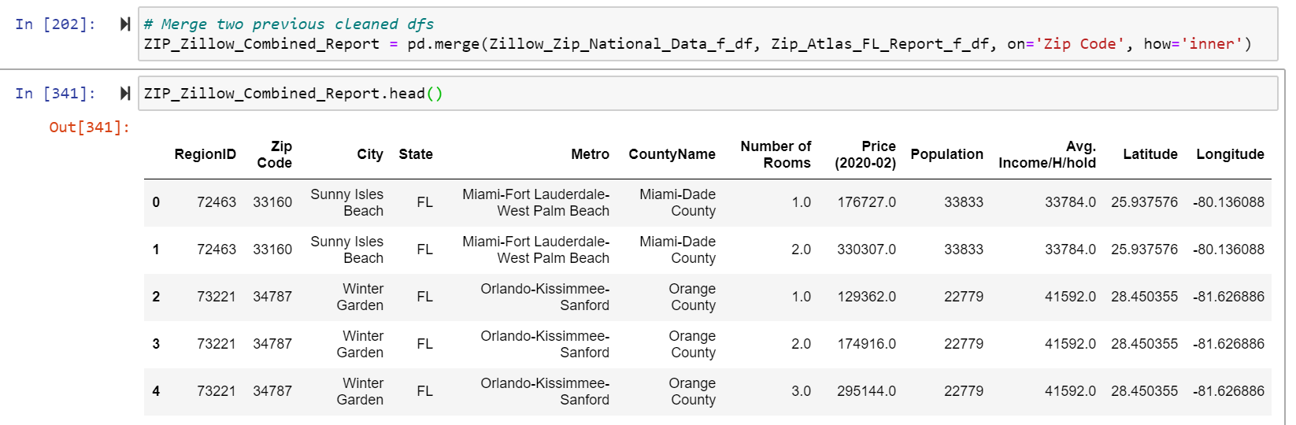
DATA CLEANING:
ZIP atlas Dataset:
Finally, we merged both Data Frames (inner) based on ‘Zip Code’ common column

Slide 11
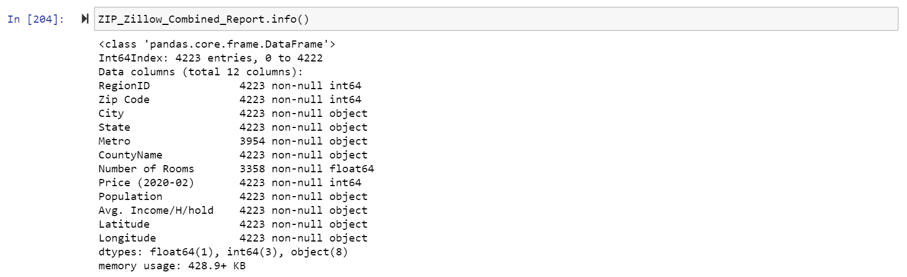
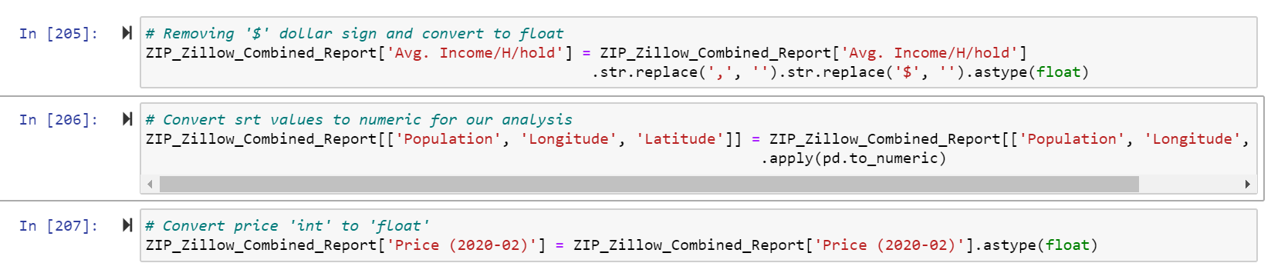
DATA CLEANING:
Merged – Combined Dataset:
After checking datatypes and data integrity using info(), we proceed to do the needed changes to numeric and float in some cases

Slide 12
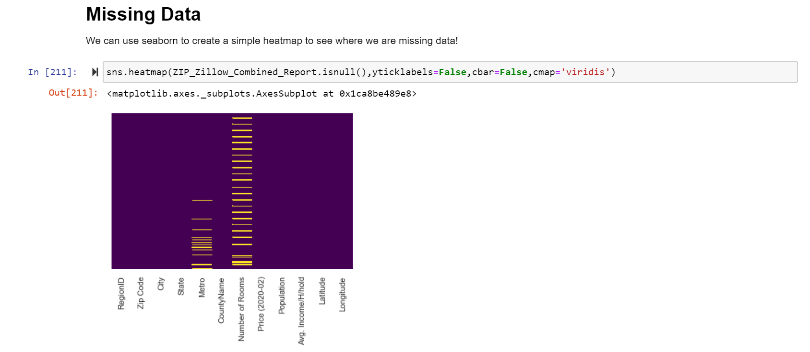
DATA CLEANING:
Exploratory analysis of final Combined DataFrame:
Using Seaborn heatmap to easily identify missing values density by column

Slide 13
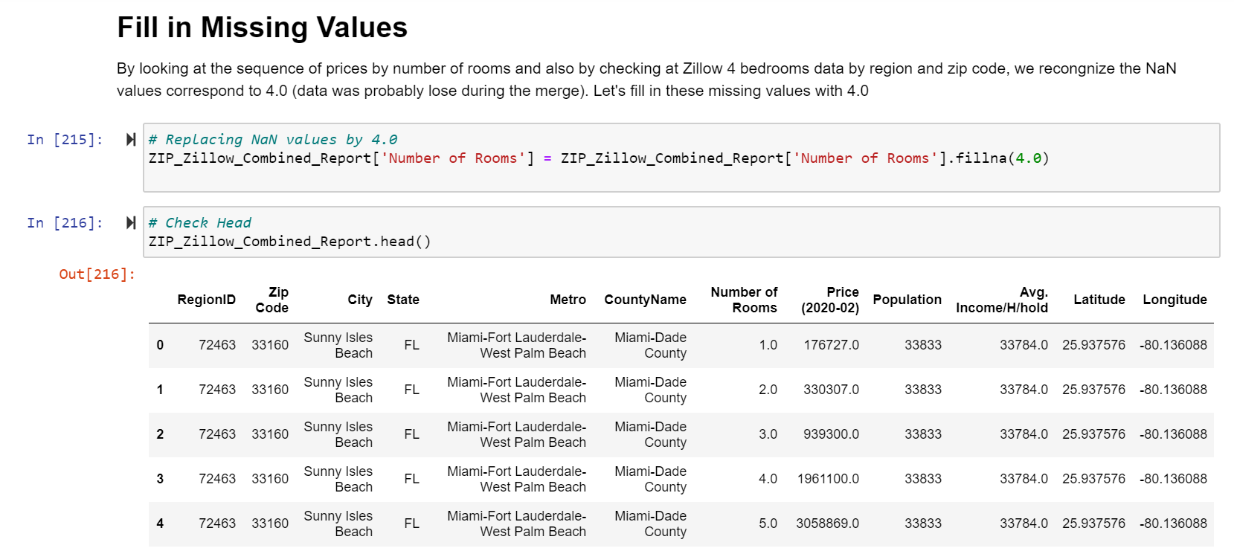
DATA CLEANING:
Exploratory analysis of final Combined DataFrame:
NaN values were filled with 4.0

Slide 14
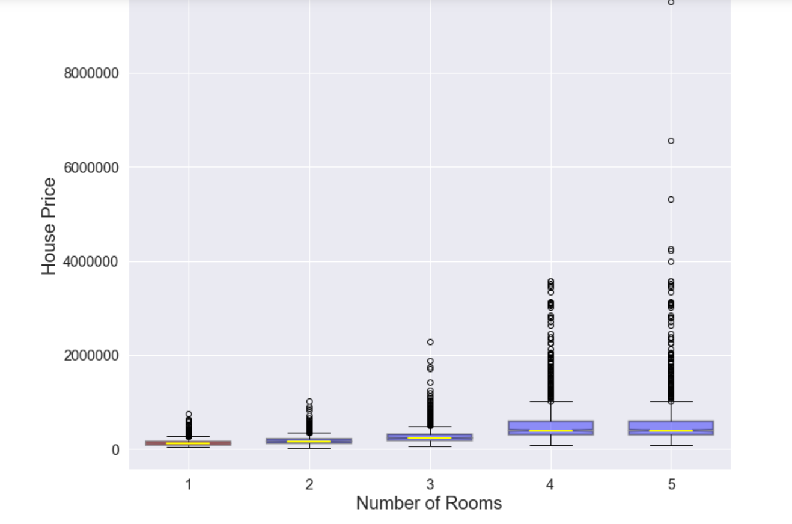
DATA CLEANING:
Exploratory analysis of final Combined DataFrame:
A Notched Boxplot was created to have a better understanding of Outliers in term of pricing

Slide 15
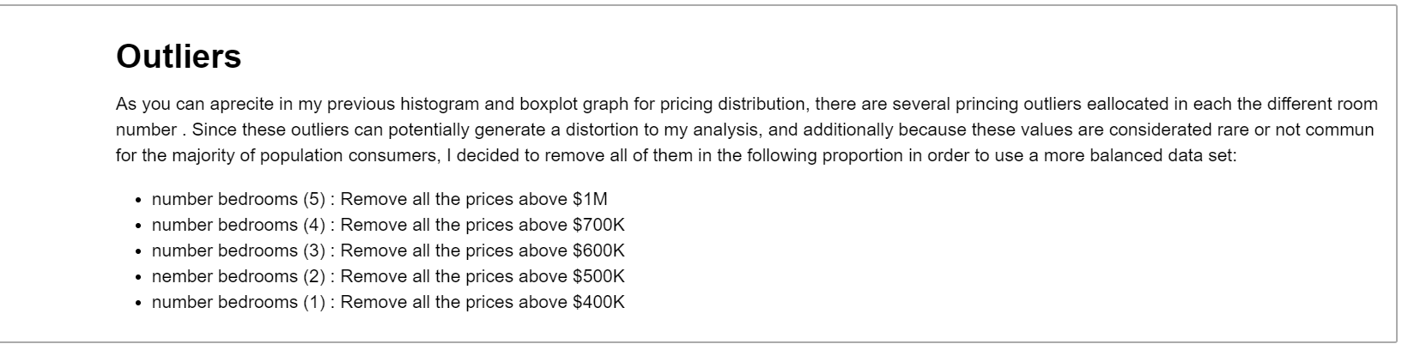
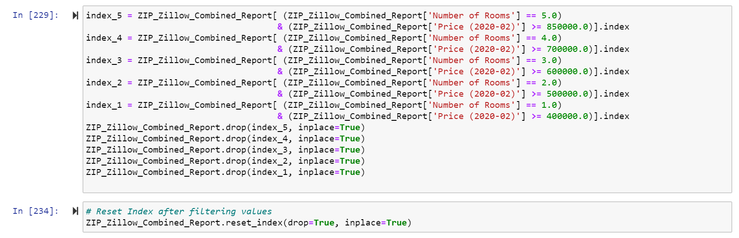
DATA CLEANING:
Exploratory analysis of final Combined DataFrame:

Slide 16
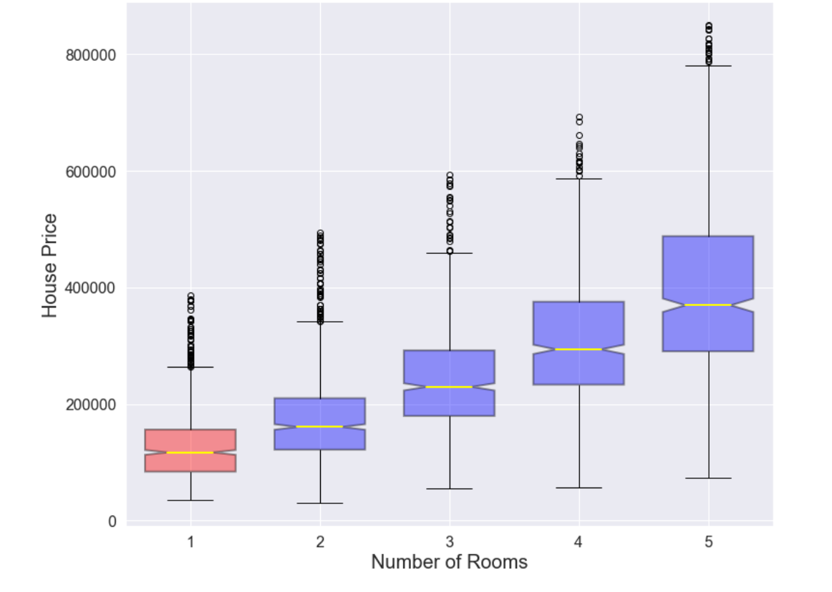
DATA CLEANING:
Exploratory analysis of final Combined DataFrame:
After removing rare outliers by # rooms a nicer Notched Boxplot was created and now we can observe that outliers remains, but more balanced

Slide 17
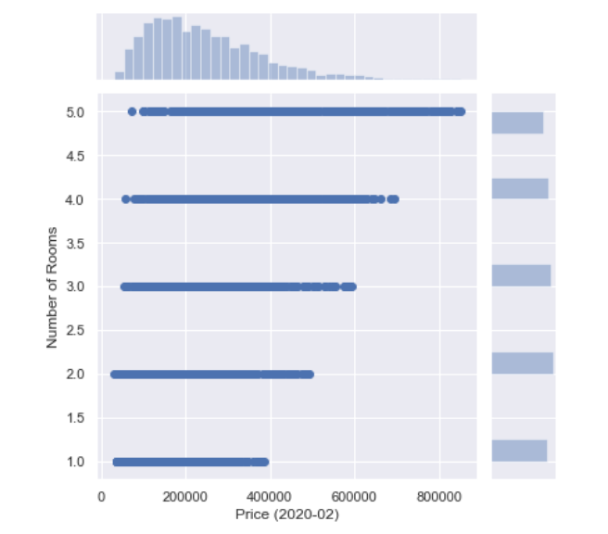
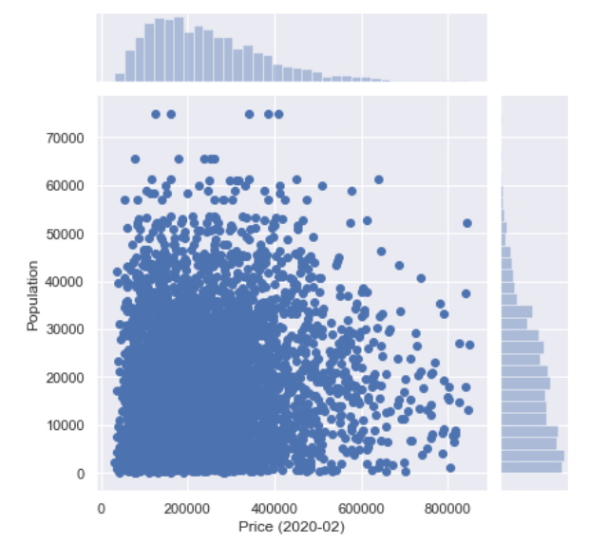
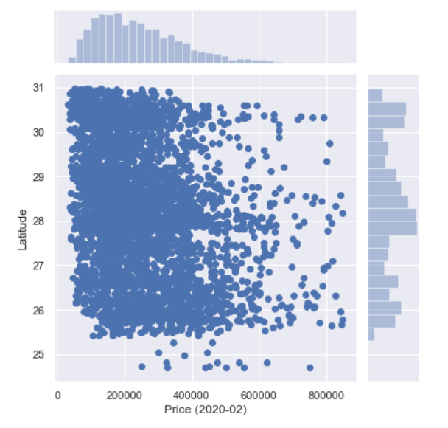
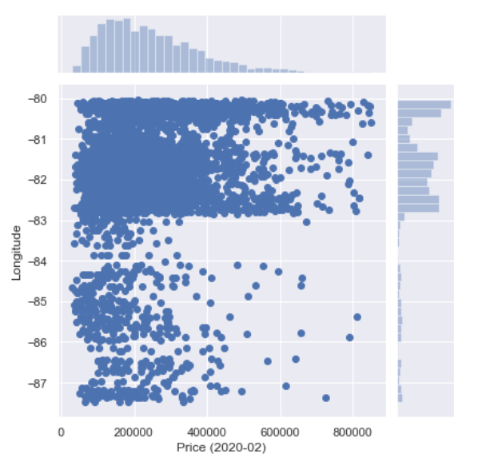
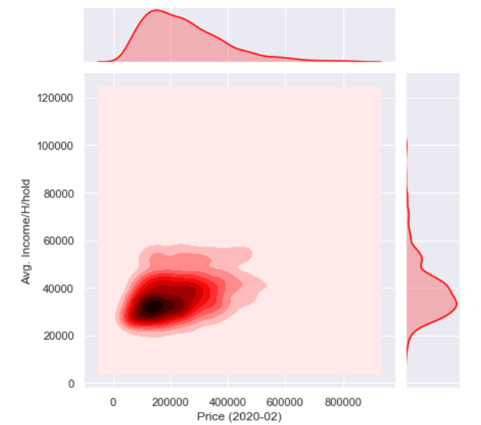
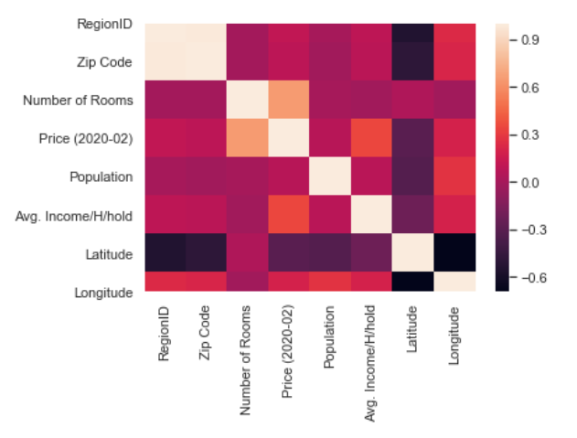
DATA CLEANING:
Exploratory analysis – Check Common Factors Affecting the House Price :
Through these comparative visualizations using Seaborn , we can appreciate the impact of independent features in the dependent variable ‘Price’

Slide 18
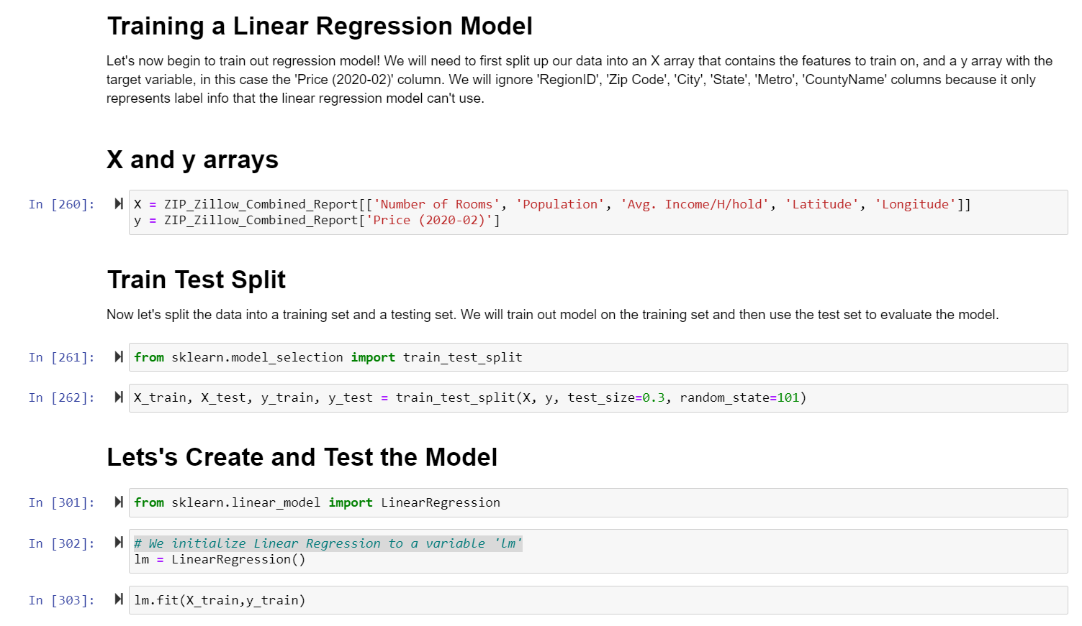
TRAINING DATA:
ML Model: Linear Regression
Simple linear regression (supervised learning) is a statistical approach for modelling the relationship between a predictor variable X and a response variable Y. It assumes there is a linear relationship between these two variables and we use that to predict a quantitative output.
Mathematically, we can express this linear relationship as: y=mx+c where y is the dependent variable, m is slope, x is the independent variable and c is the intercept for a given line.

Slide 19
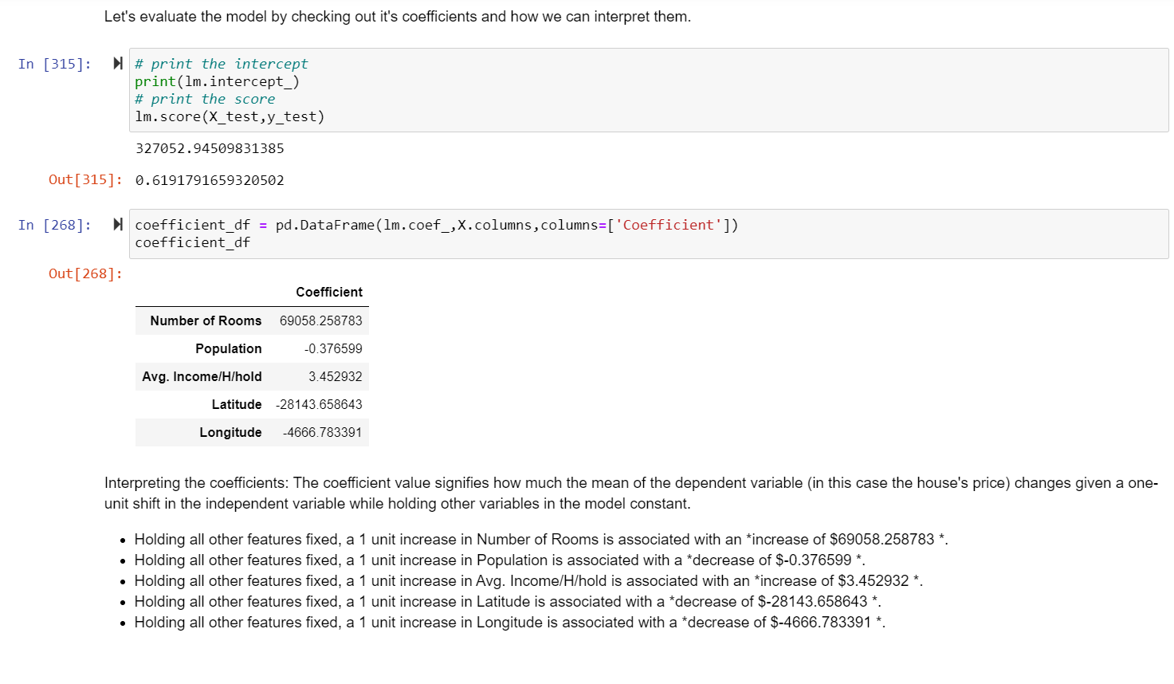
MODEL EVALUATION:
ML Model: Linear Regression
After fitting the data to our model, we check the score as an evaluator of the performance of our prediction. In this case our prediction was 61.2 %

Slide 20
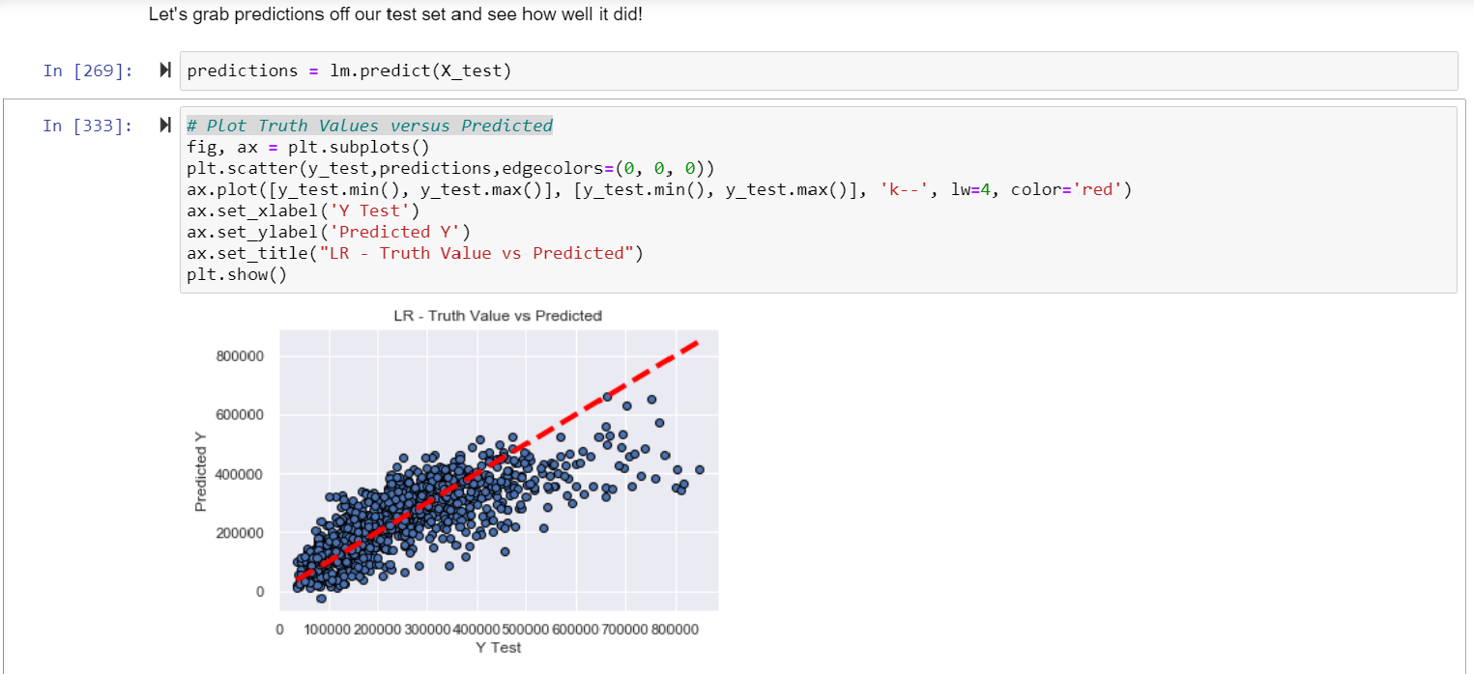
MODEL EVALUATION:
ML Model: Linear Regression

Slide 21
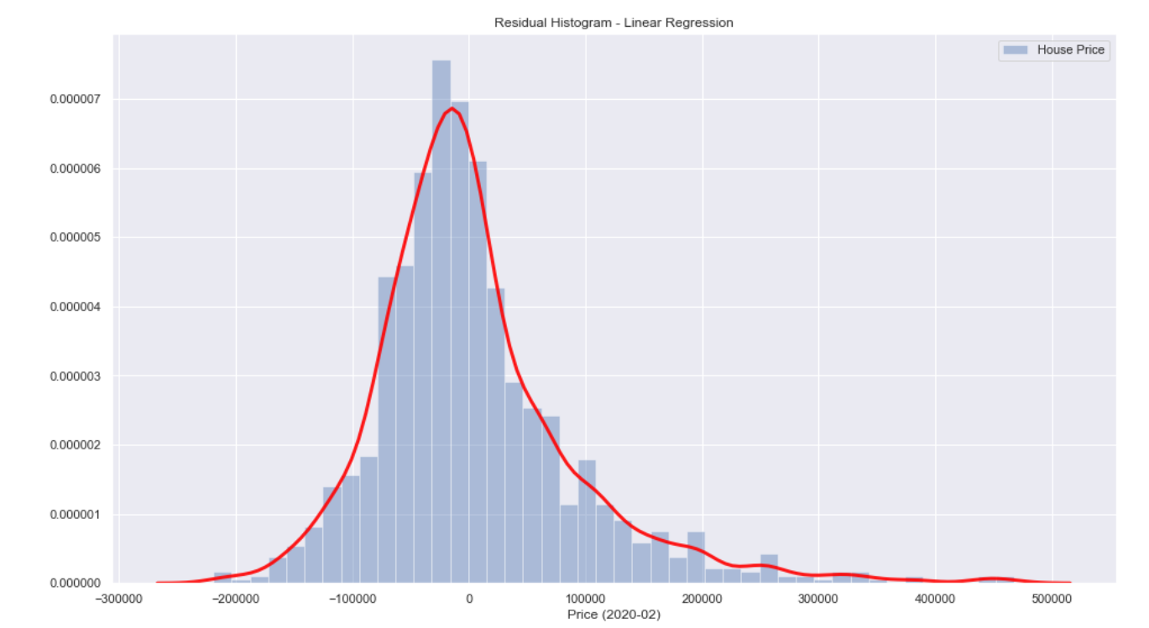
MODEL EVALUATION:
ML Model: Linear Regression
Let’s take a look at the residual errors (y-y^) → Actual - Predicted

Slide 22
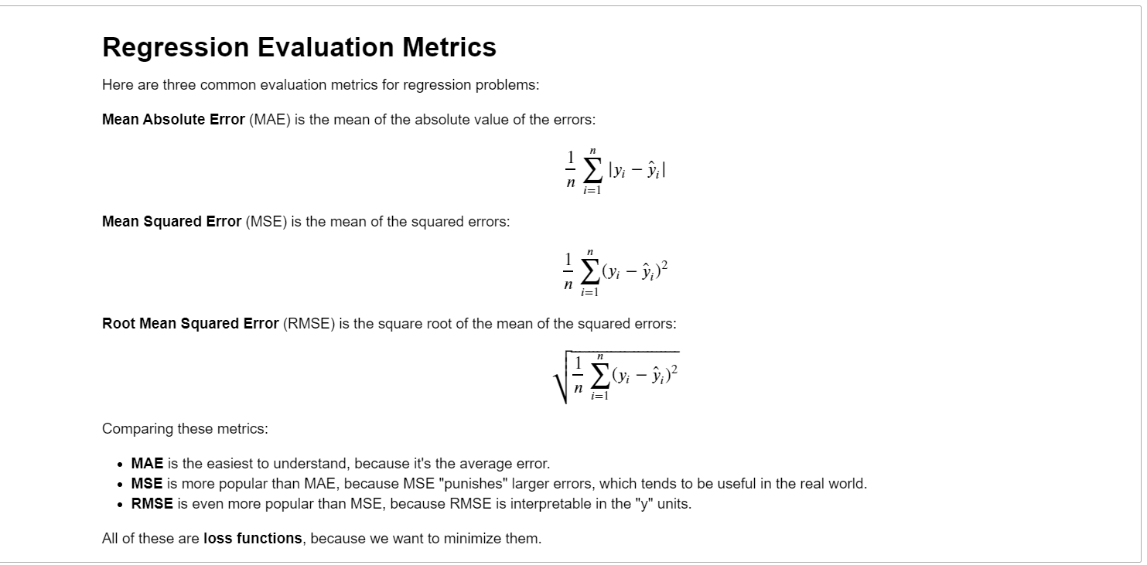
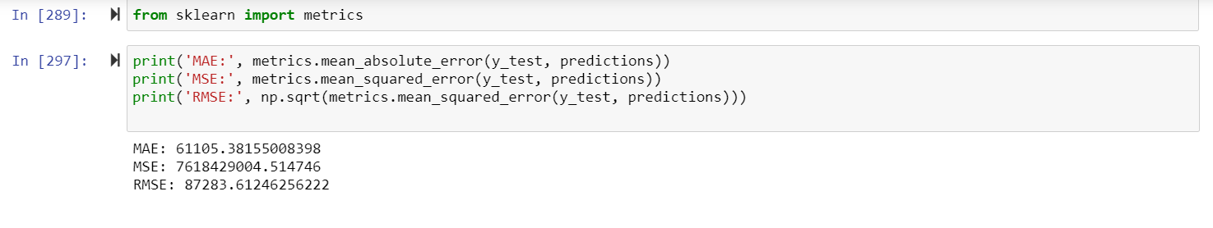
MODEL EVALUATION:
ML Model: Linear Regression

Slide 23
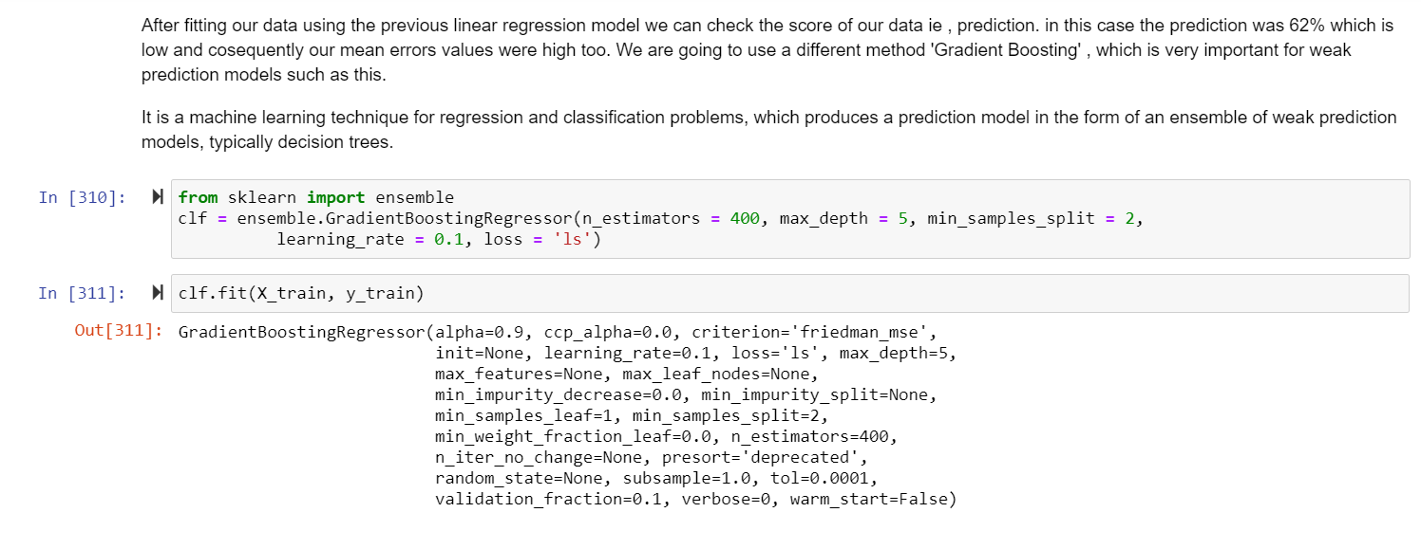
TRAINING DATA:
ML Model: Gradient Boosting Regression
. The idea of boosting came out of the idea of whether a weak learner can be modified to become better. A weak hypothesis or weak learner is defined as one whose performance is at least slightly better than random chance.
The objective is to minimize the loss of the model by adding weak learners using a gradient descent like procedure
maximum depth of the individual regression estimators
minimum number of samples required to split an internal node
# of trees in the ensemble

Slide 24
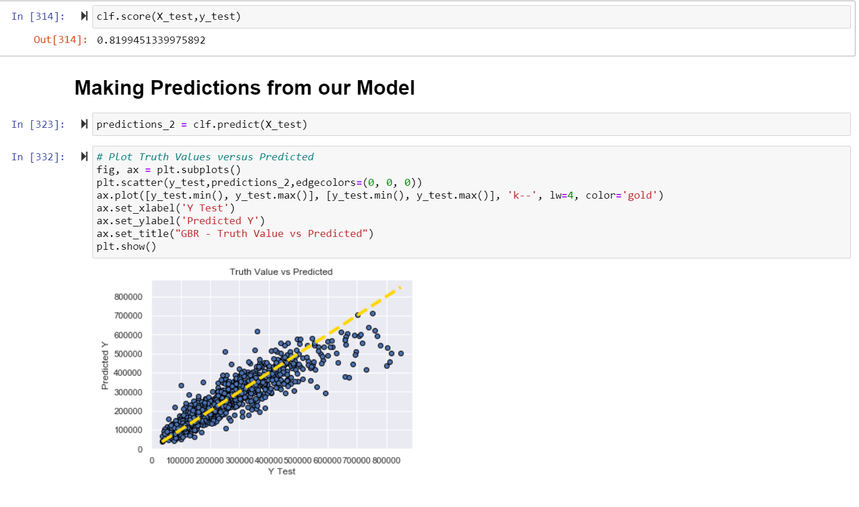
MODEL EVALUATION:
ML Model: Gradient Boosting Regression
After fitting the data to our new model, we check the score as an evaluator of the performance of our prediction. In this case our prediction was 82 %

Slide 25
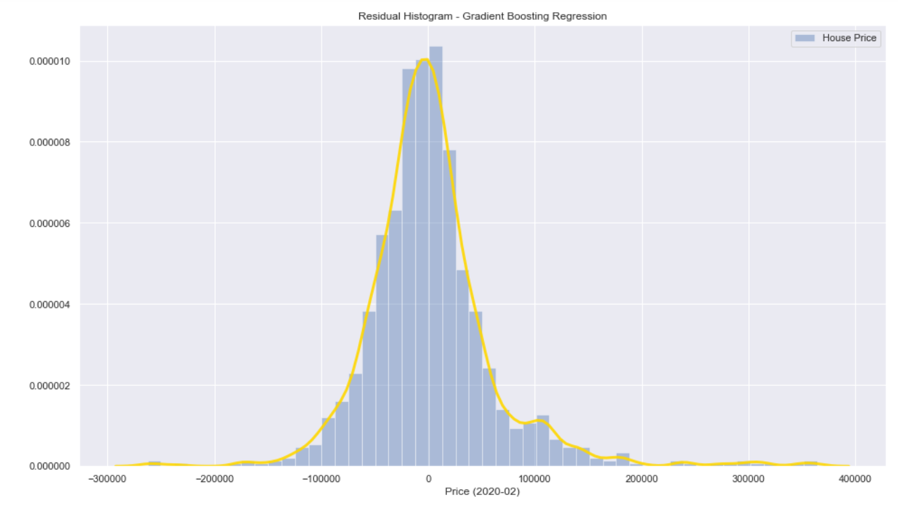
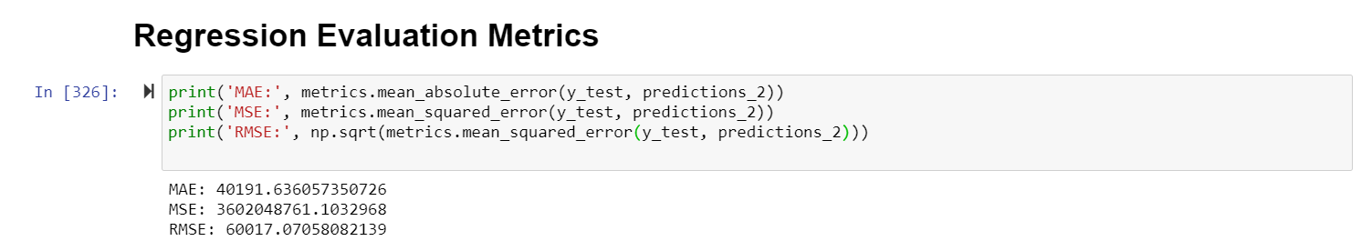
MODEL EVALUATION:
ML Model: Gradient Boosting Regression

Slide 26
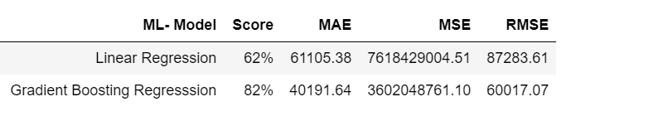
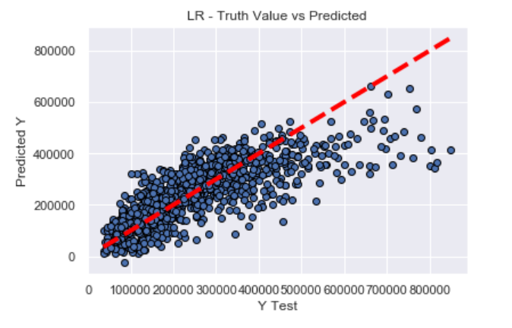
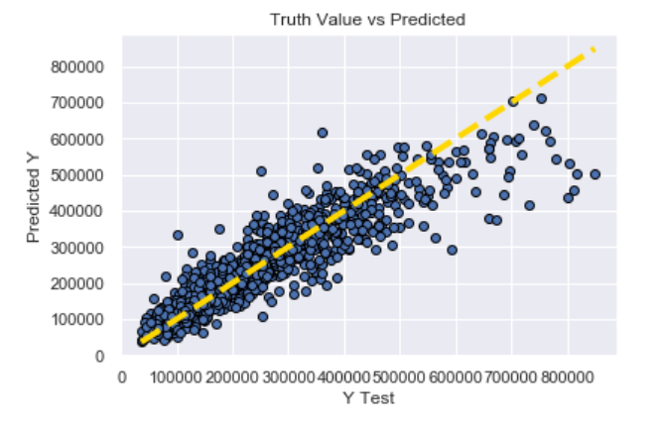
MODEL DIFFERENECES:
Linear Regression
Gradient Boosting Regression

Slide 27
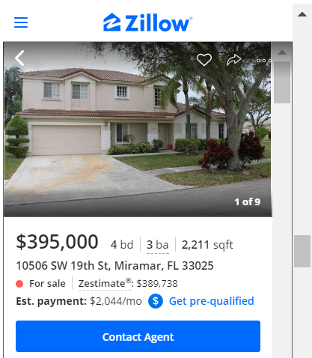
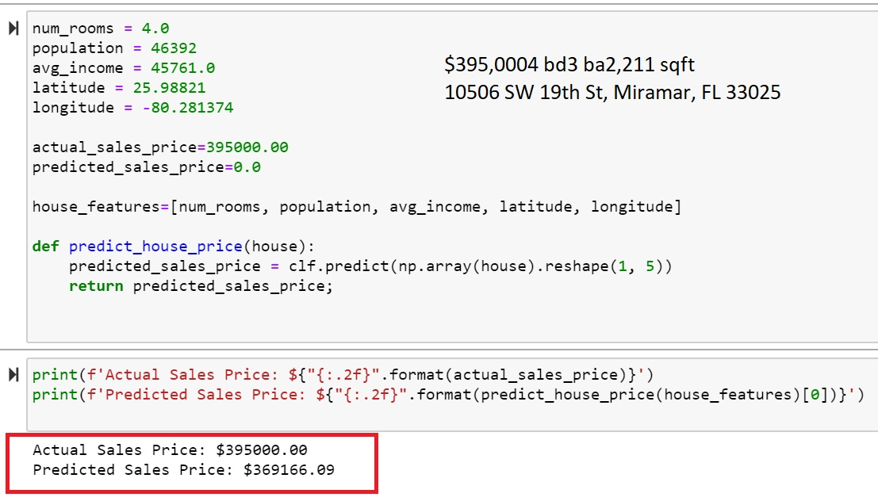
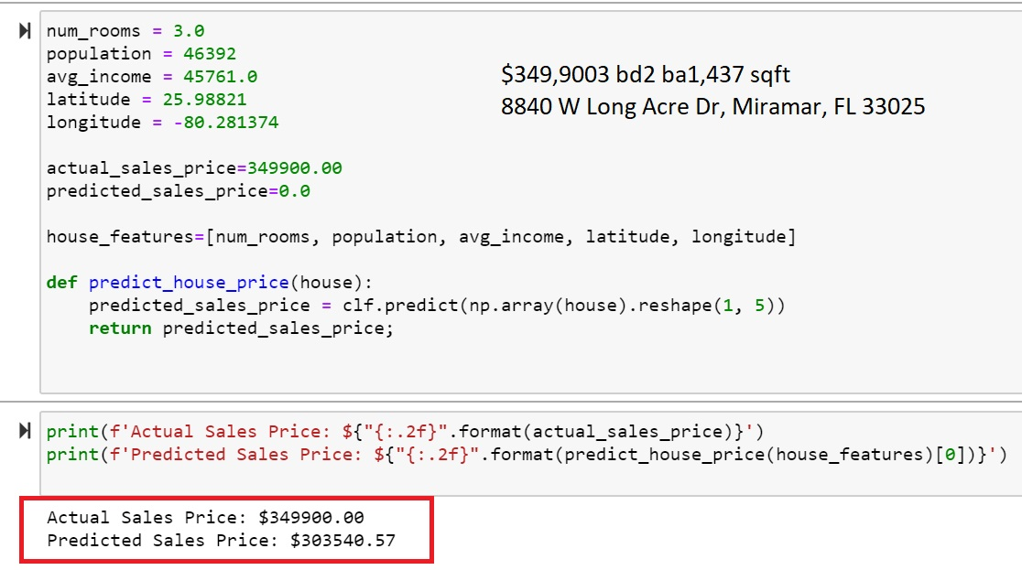
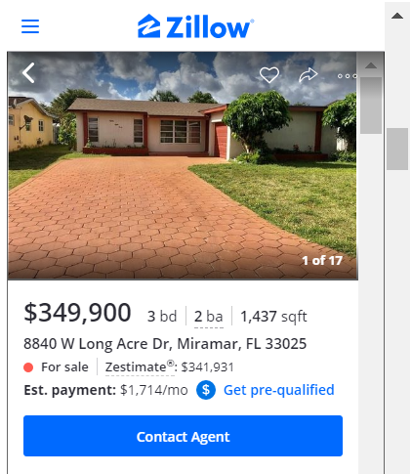
Some house randomly selected from Zillow to evaluate my last model’s predictions

Slide 28
Next Steps:
Enrich my data set with more information (#bathrooms, area sq. feet, #garages)
Test again my previous models or try others in an effort to improve predictions
Finally create a visualization solution to deploy my model > Tableau (tabpy-server)
QUESTIONS !

